Slide 1
JMIR (Journal Name)

Slide 2
About the journal
Journal name (J##) is
‹#› |

Slide 3
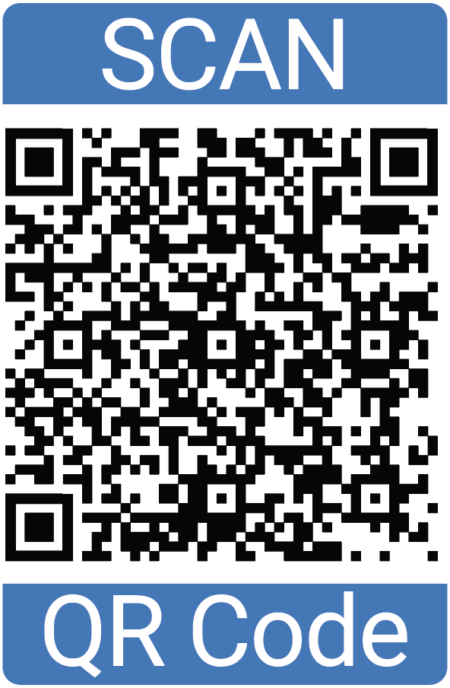
Join the Editorial Board
JMIR Publications is actively looking for new members to join the editorial board for each journal. Our editorial boards are composed of outstanding individuals committed to rigor in scientific review and excellence in providing educational feedback for authors.

Slide 4
Editorial Board

Slide 5
Stay connected
https://jmir.org
@jmirpub
@jmirpub
linkedin.com/company/jmir-publications
@jmirpub.bsky.social
@jmirpub
@jmirpublications
@jmirpub
support@jmir.org

